Slide 1

NEW YORK CITY
Restaurant Ratings & Reviews
NYC Restaurant Week 2018
Presented By:
Muntasir Billah
Purnima Pathak
David Jolia
Matt Siriani
Elizabeth Veltre

Slide 2
ABOUT THE PROJECT
Project Name
New York City Restaurant Ratings & Reviews
Background
Rutgers University is organizing an educational tour to New York City for its diverse student body. To enhance their experience, Rutgers has enlisted the help of Team-2 Agency to analyze a NYC Restaurant dataset and provide visualizations that showcase the types of restaurants available in the city, along with their pricing and the cuisine they offer. The goal is to identify the best restaurants to visit during the students' stay and ensure they have a memorable culinary experience in NYC.
Description
This project explores restaurant ratings, food reviews, and location-based information to provide insights into the vibrant culinary scene of New York City.

Slide 3
TOOLS
Postgres
Flask
Leaflet
psychopg2
Visual
Studio
flask_cors
jsonify
Chart.js

Slide 4
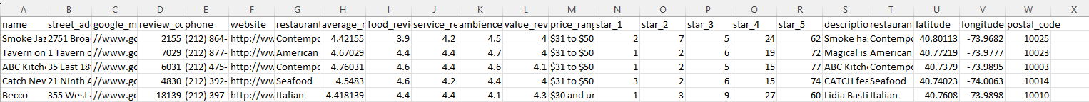
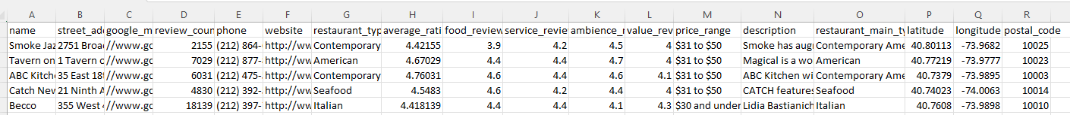
CLEANING THE RAW DATA
Deleted unwanted columns and changed column headers
Saved as a CSV file
Original Data
Cleaned Data

Slide 5
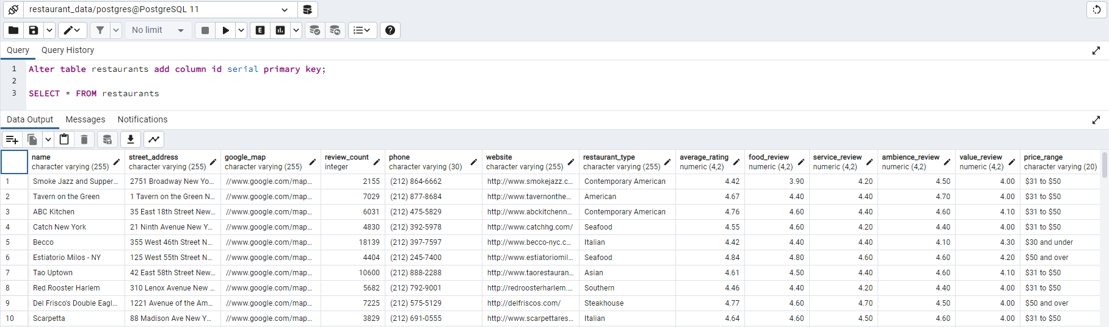
CREATING THE DATABASE
Created the restaurant database in Postgres
Imported the data from the CSV file
Added a numeric ID column as the Primary Key

Slide 6
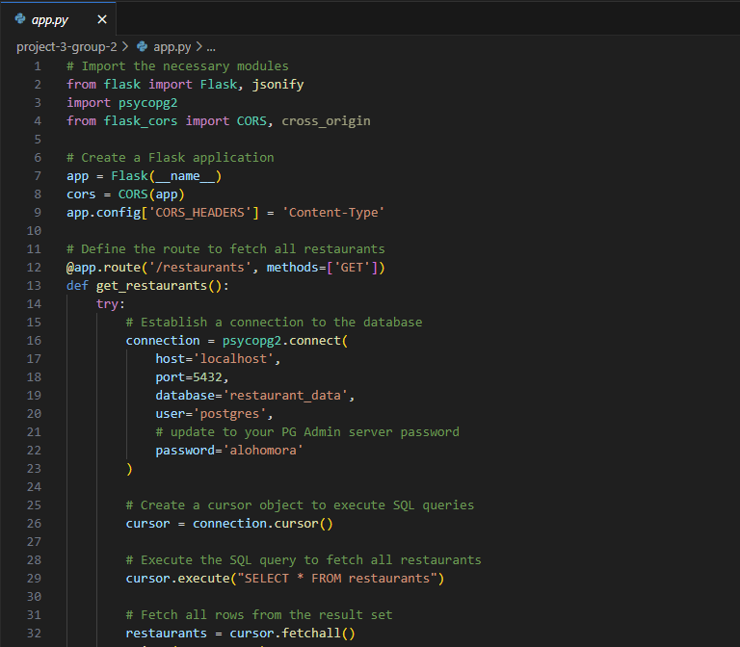
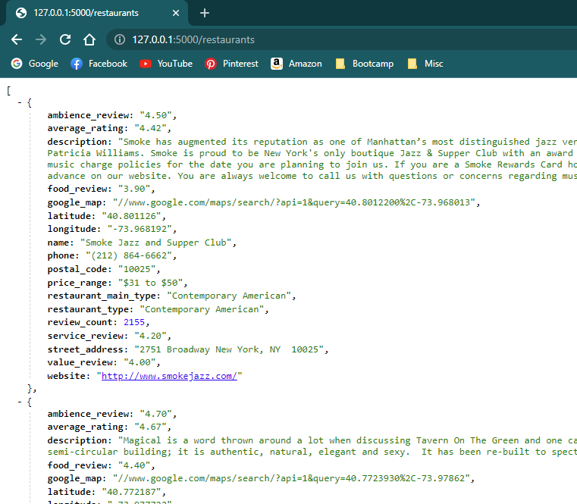
CREATING THE FLASK APP
Created a Flask app that read from the SQL database

Slide 7
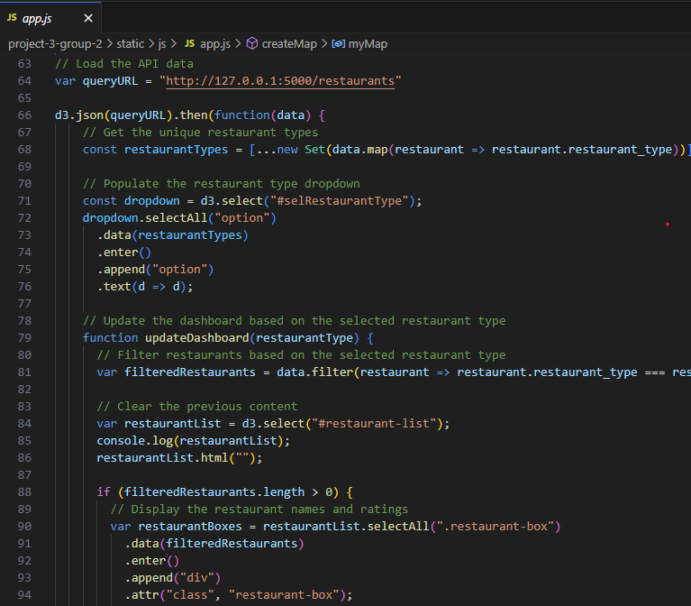
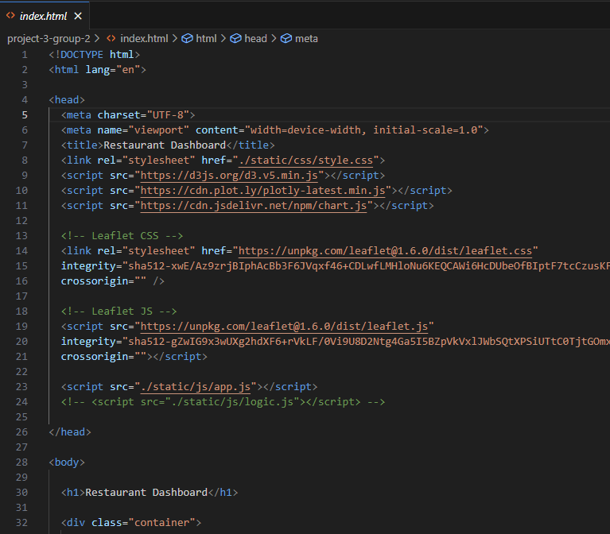
HTML, JS, & CSS
Built an HTML file for page structure, JavaScript for functionality, and CSS for styling

Slide 8
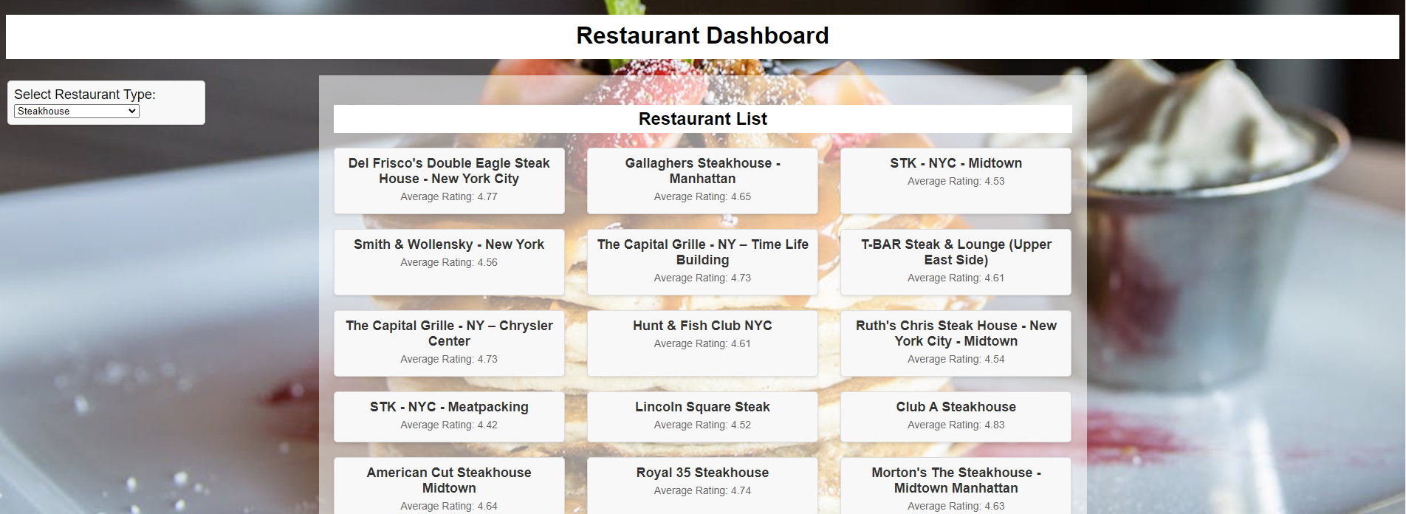
RESTAURANT DASHBOARD
Restaurant Dashboard and Dropdown Menu
The Restaurant List changes according to what is selected in the dropdown menu

Slide 9
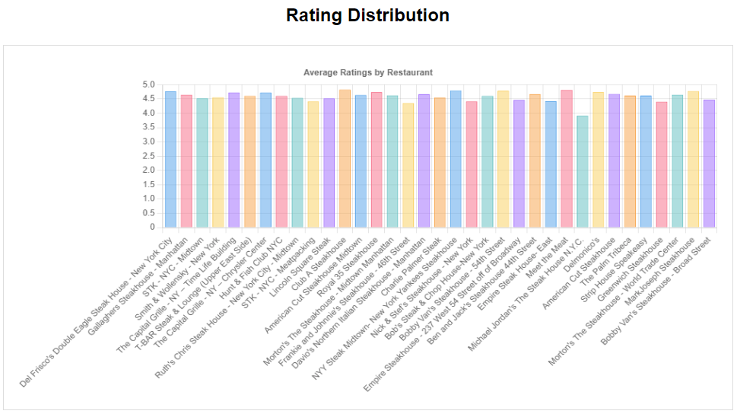

AVERAGE RATINGS
This chart shows average restaurant ratings based on selected restaurant type
A user can make a quick decision where to eat by looking at the rating chart

Slide 10
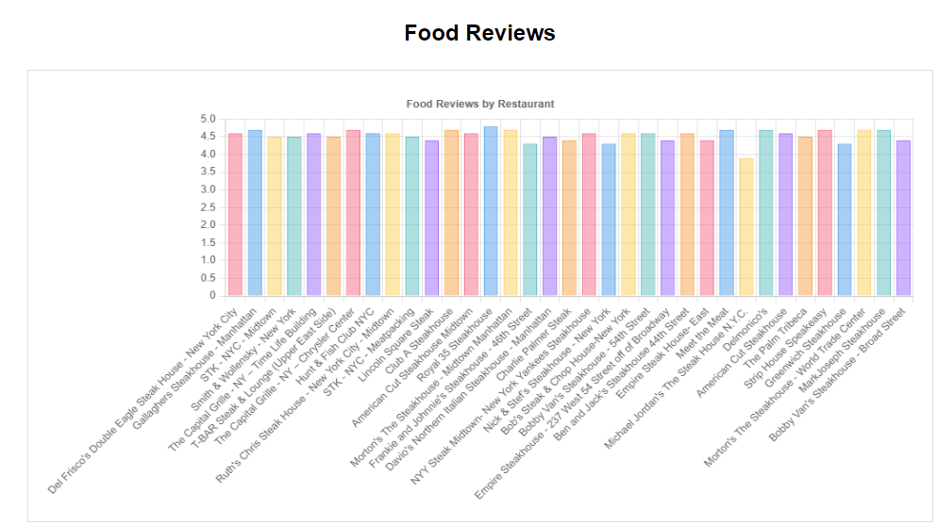

FOOD REVIEWS
This chart shows food reviews from customers based on the food they had
By looking at this chart, a user can determine which restaurant has the best food

Slide 11
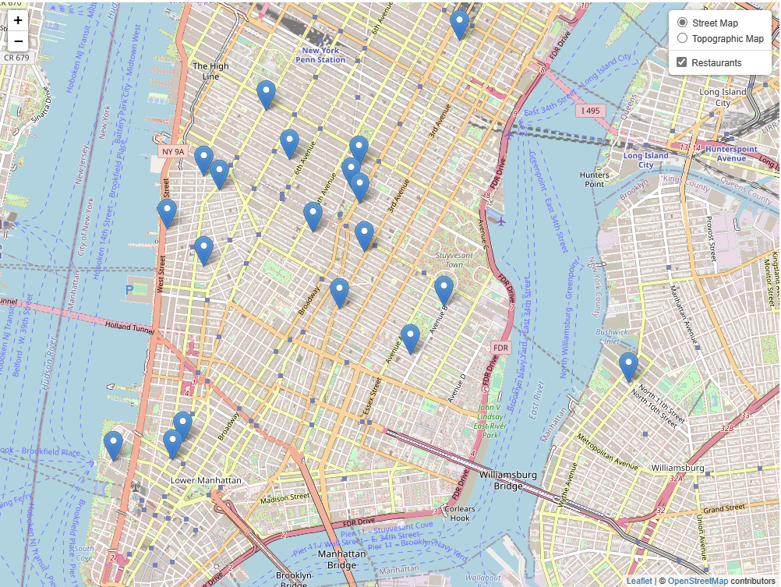
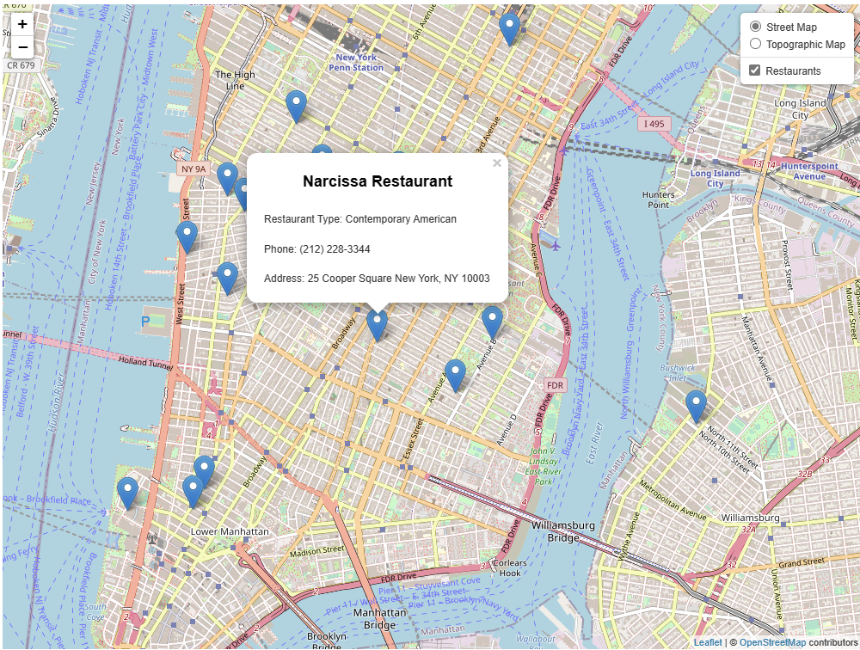
RESTAURANT LOCATIONS
The Leaflet map shows each of the restaurants in New York City
Clicking on a marker triggers a pop-up that displays the restaurant’s name, type of cuisine, phone number, and address

Slide 12
DATASET & OTHER SOURCES
https://www.kaggle.com/datasets/popoandrew/restaurant-week-2018
https://www.chartjs.org/docs/latest/

Slide 13

THANK YOU
AND
ENJOY YOUR MEAL!!!

